Slide 1
Northwest Fisheries Enhancement
Presentation- A Unique New Fisheries Enhancement Group

Slide 2
NWFE Overview
A Unique New Fisheries Enhancement Group
Build the most return for your mitigated responsibility
Maintain or Reduce Rate Payer Cost
Value Added Approach
Utilize NGO efficiencies
Recruit Partners
Avoid Pitfalls of Contracting with your Regulatory Agency-
Build Return on Investment
NWFE- creative programs towards Natural Origin and Hatchery management
Pro-active Advocacy- Public Relations
Build Community Support
Drive Economic Impact
Best Practices for Hatchery and Natural Origin fish management.
Planning and regulatory reporting
Improve Results for your rate payers, customers and communities.

Slide 3
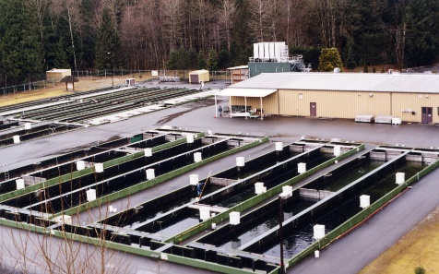
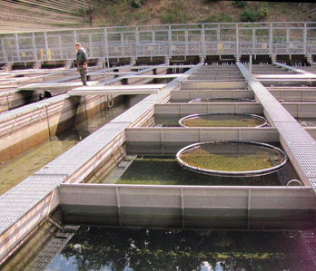
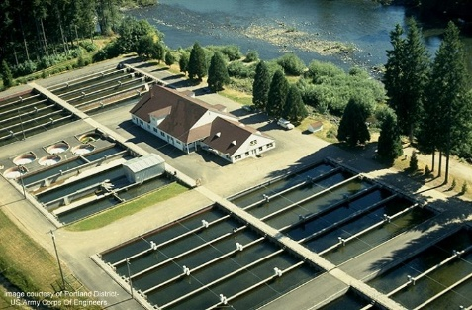
NWFE- A Unique New Fisheries Enhancement Group
Working for you to meet new challenges
Building Public Private Partnerships,
Building competitive options
Value Added approach
Inside of the box with one side open, add to the box creativity
Bridging Aquaculture, Tribal and Stock Enhancement practices to Value engineer, Goal and Result driven through proven and modern best practices for your fisheries enhancement program
You won’t see this type of presentation from our competitors.

Slide 4
Is your contractor managing efficiently and towards your direction? Or just “need more money” and the results are concerning?
1
Value engineering to your goals and directions
2
Cheaper, Better, Faster
3
Goal and Results Oriented
4
A fresh new perspective in fisheries

Slide 5
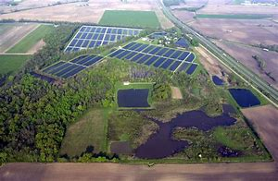
Crossing Borders
Cross Borders- Consistent management from one state to another- with Best Practices for Hatchery and Natural Origin Conservation fish management without the constraints of borders and bureaucracy environment with the mobility of our NGO structure. Yet meeting local needs and reporting.
Bringing seasoned fisheries, business, finance, public personnel and executives with a passion for fisheries enhancement in our waters of the Northwest to develop or strengthen programs to ensure and increase the adult return rates and their survival.

Slide 6
NWFE Will Bring In The Right People
Working with people of the Northwest to develop or strengthen programs to ensure and increase the adult return rates and their survival.
Bringing seasoned fisheries
Work with pubic personnel
Work with passionate people.
Bring in business and finance partners
Providing Best Practices for Hatchery and Natural Origin fish management, meeting responsible, modern practices for hatchery and wild/ natural origin Salmon and Steelhead management. Utilizing innovation from practices that will improve Fish Health and Adult Returns. -Bridging Aquaculture and Stock Enhancement worlds,
Building return to you, your rate payers, customers, employees, the watershed communities through a Value -Added approach!

Slide 7
Build the most return for your Mitigated Funding. Maintain or Reduce Rate Payer Cost,
S
Hydroelectric industry changes drive mitigated funding management to more efficiency.
Cost maintenance, identify true cost, evaluate, restructure and Value engineer existing facilities and programs to increase efficiencies.
Creative project cost management, Value Engineering -Incentives to Contractor
Creative and incentivized employees, programs establish goals, re-organize to include full, part time and volunteer employee work force and training programs.
Adaptive Management practices
Improve efficiencies,
Reduce costs - Utilize NGO efficiencies
Sustainability means change.
Decrease wasteful and hidden spending
Value Added multi prong approach-
.
A
V
E

Slide 8
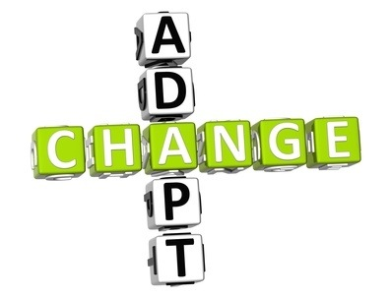
NWFE - it’s NGO (nongovernmental organization) efficiencies
NWFE-
Is flexible in adapting to local situations and responding to local needs and therefore able to develop integrated projects, as well as sectoral projects.
Will enjoy good rapport with people and can render micro-assistance
Can communicate at all levels, from the neighborhood to the top levels of government.
Can experiment freely with innovative approaches and, if necessary, to take risks. Can recruit both experts and highly motivated staff with fewer restrictions than the government.
Local accountability & Independent assessment of issues and problems
Expertise and advice in Reaching important constituencies
Provision and dissemination of information
Awareness-raising & Private sector lower overhead, efficiency and effectiveness
Improved access to private, government, non-profit capital
Asset management
Access to learnings from commercial fisheries management
Rapid and pragmatic deployment of private and public technology
Higher level private sector management capabilities

Slide 9
Management
Professional management
Employee management flexibility, redirection, team orientation, incentivize, develop goal and results orientation, build part time and volunteer community sources for large and small project support.
A community part paid, part volunteer fire department like approach, with training and
command structure, certification and local support
Hundreds of volunteers

Slide 10
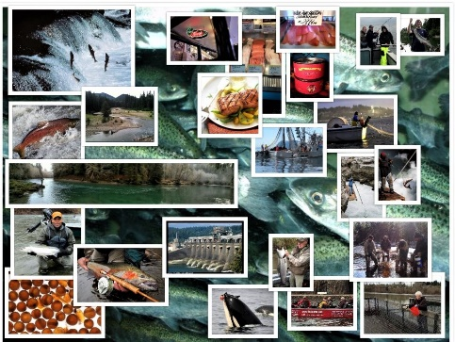
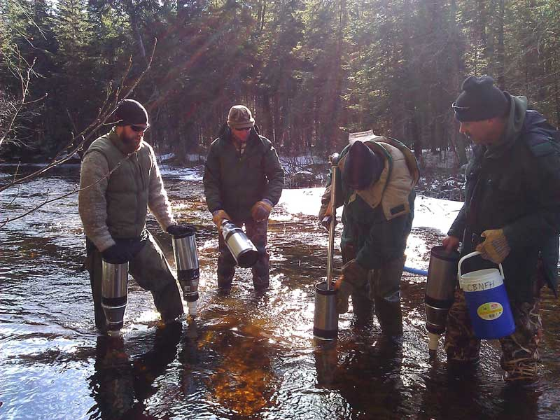
Recruit Funding Partners
Recruit funding and in-kind partners from typical and non-typical, mitigated or perceived mitigated and interested groups that can benefit from co-aligned returns.
Project or facilities Naming rights, shared revenue
Partner and employee participation
Corporate local, regional, national and international
Local, state and federal
Regulatory agencies
Community groups and businesses, a chambers of commerce approach
Leverage utilities partners and contractors
Fisherman & Off Coast fishing fleets

Slide 11
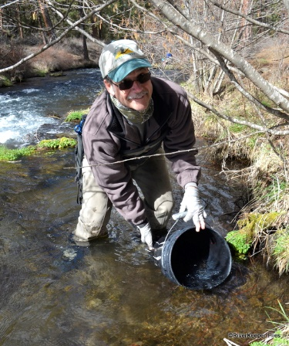
Best Practices for Hatchery and Natural Origin fish management
Bridging Aquaculture, Tribal and Stock Enhancement worlds, meeting responsible, modern practices for hatchery and wild/ natural origin Salmon and Steelhead management. Utilize innovation from both practices that will improve Fish Health and Adult Returns.
Goal and results oriented
Improve Successes, establish goals and improve efficiencies.
Best practices training,
Project management Data collection, Interpretation, Analysis and system upgrades.
Independent Fish Health & Veterinary

Slide 12
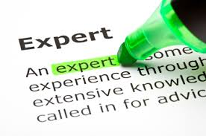
NWFE Expert Team
Our team has a tested method for implementing a Fish Health Management Strategy tailored specifically to each facility. It incorporates active training in scheduled fish health checks, proactive sampling to mitigate risks of health issues, established relationship with fish health expert as well as lab testing facility, and establishment of an Emergency Health Issue Response Plan to reduce loss and administer quick solutions.
We welcome any independent Fish Health reviews.
Bring seasoned fisheries, business, finance, public
personnel and executives with a passion for fisheries
enhancement in our waters of the Northwest to develop
or strengthen programs to ensure and increase the adult
return rates and their survival.

Slide 13
Provide Planning and Regulatory reporting
NOAA, NMFS, FERC, Federal agencies and Legislature and the administration have new priorities, guidance and strategic goals.
Driving fishing opportunities while ensuring the sustainability of fisheries and fishing communities sustaining, economic impact and building fishing opportunities should be prevalent in your planning and will be required.
Recovery and conservation of protected species while supporting responsible fishing and resources development.
Improve organizational excellence and regulatory efficiency.
The Administration's Executive order 13771 (Reducing Regulation and controlling Regulatory Cost) may additionally open some windows and relief for you.
Driving Economic Impact and receiving the return for you and the millions of dollars spent is Value- Added component of NWFE 5- years, 10- year planning

Slide 14
Fish Hatchery Management Planning
NWFE offers Fish Hatchery Management Planning (FHMP), Hatchery Genetic Management Planning (HGMP), Hatchery Scientific Review Group (HSRG) guidelines and regulatory reporting including these new priorities can be provided. With NGO efficiencies working for you and reducing your costs towards the process.
NWFE Brings seasoned fisheries, business, finance, public personnel and executives with a passion for fisheries enhancement to develop or strengthen planning and reporting programs. With experienced backgrounds, Bachelors, Master’s and Doctorate level planners and reporting developers and project managers from a varied spectrum to deliver at cost below your current options and with NWFE value added benefits.

Slide 15
Value Chain – Industry minded approach to improving hatchery fish performance:
Preliminary cost benefit analysis
Hatchery production
Value Chain
Production
Fish Performance
Analyze hatchery management
Need to analyze hatchery management and fisheries/environmental management. It’s not good to focus solely on fish production. Increasing returns will take a combined approach.
Getting it done in one fell swoop
Management

Slide 16
Hatchery Management Aspects To Review:
Current production protocol: Identify, if any, issues that need to be addressed during the rearing cycle, identify the target production and see if this is being reached. Production amount may need to be changed to maximize returns. Identify what size the fish are being released, how, and where they are being released.
Evaluate if releasing some at fry stage, some at par stage, some at smolt stage would increase adult returns.
Feed/nutrition improvements: Assess feeding regime.
Establish Fish Health Management Plan for proactive approach to maximizing immunocompetence. Identify if there are any recurring fish health issues; if so, figure out ways to improve overall fish health.
Maximize fish production whilst closely monitoring cost: Can production be increased or improved without significantly raising the cost. Analysis of returns to cost of rearing and release – “cost per fish of an adult return”
Establishment of a “Standard of Release” –assessment of any hatchery fish to be released; fish for wild release must meet minimum criteria for average growth, health and immunocompetence, and deformity rates.
Community inclusion and training: active interest and interaction with community establishes good PR for these efforts and demonstrates to the public sustainable practices are being followed. In addition, a well established volunteer program reduces overall labor cost.

Slide 17
Fisheries/Environment Management:
In-depth environmental assessment of release area and path to sea: Assess current spawning locations, can they be cleaned to improve wild spawning success. Can the river be improved to increase habitat for wild salmonids, is agricultural run-off an issue in the surrounding catchment area, Could improvements be made to allow easier passage of adult fish back to spawning areas.
Genetic Management: Involvement of both fisheries management specialist and geneticist to asses existing plan for genetics and incorporation of improved hatchery methodology to meet improved expectations for diverse stocks
Conservation Projects & Integrated Best Practice
Recognize and utilize hatchery resources to assist Natural Origin
Wild fish are free fish
Rebrand to Conservation hatchery, conservation natural origin programs

Slide 18
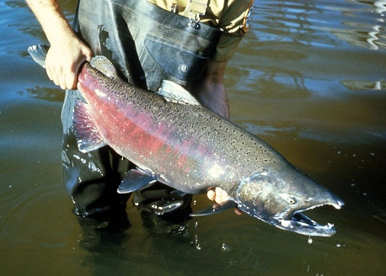


Build Economic Impact-
Adult returns drives economic impact-
A bi product of better fisheries enhancement management that you should be getting credit for.
Adult returns mean trickle down Economic Impact-
$1230. Of economic impact per caught recreational fishing salmon through trickle down, tourism
Real estate values
Outdoor recreation now outpaces major US sectors
Get credit deserved for economic impact, real-estate values and jobs created by your mitigated fisheries enhancement dollars spent.

Slide 19
Build Community Support,
Integrate the watershed Community into programs
Drive jobs-economic impact, get credit deserved
Address Community concerns with adult returns.
Build return to the community for their programs.
Utilize community volunteers and groups for programs.
Build a grass roots effort
Fisherman involvement in river reporting, fish biology, regulatory reporting and give back programs-
Fishermen and guide Ambassador programs to their customers
Chamber of commerce approach and business involvement

Slide 20
Avoid Pitfalls of Contracting with your Regulatory Agency-
Contracting with your regulatory agency to provide services creates discussion, arguments and pitfalls that can be avoided.
How is it that you can contract with your regulatory agency?
Avoid the pitfalls, concerns of a regulatory agency mischievous and miss-behavior.
Rumors of coercion, pay offs and more for regulatory relief.
The Regulatory agencies hold you at ransom with threats of regulatory retaliation if loss of contract.
Avoid expensive litigation and investigation.
NWFE will be better positioned as a contracted NGO to dissuade this behavior, through pro -active and offensive public relations, advocacy and legal programs.

Slide 21

Build Return to Utilities
6 to 10 times or greater return on investment.
For every dollar spent you should see 6-10 dollars of return.
A proactive and offensive Public Relations Program-
Build rate payer support and loyalties,
Build river communities support and loyalties
Build Regulatory agency support and inclusion
Messaging to Multimedia with positive media
Industry workshops and conferences,
Recruit Partners
Receive recognition from regional and national industry
Receive recognition from Federal, regional and local regulatory agencies.

Slide 22

Advocacy for Utilities
Pro Active advocacy through public relations-
Advocate to Regulatory agencies, include regulatory agencies.
PR to community with community
PR to rate payers, customers
Pro-active and offensive Advocacy and PR to Utilities decision makers, regulatory agencies
NWFE can be better positioned as a contracted NGO to dissuade this behavior, through pro -active and offensive public relations, advocacy and legal programs.
An offensive pro-active
Through media outlets online, print and TV, social media
Divert and prevent expensive Litigation.
shifting to a Adult Return Goals- within the SA limitations.
Legislative tours
Workshops,
Conferences
Speaking engagements
Utilize pro benefits of economic enhancement, jobs, tourism, trickle down
TV show
Direct advocacy to regulatory agencies, federal, regional, state.
NOAA new priorities are key to drive programs and hatchery direction, regulatory reform and may lift some expense.

Slide 23


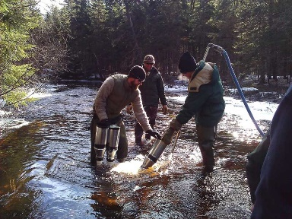
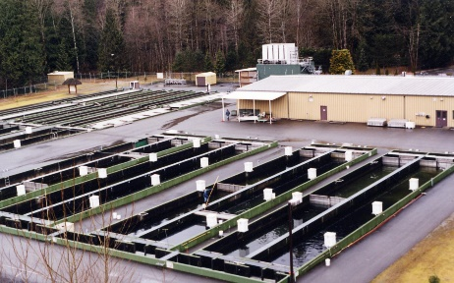
Advocacy is a Value-Added NWFE component
Improve Results for your customer and communities.
Shift into a Rebrand and Reorganize to Conservation Programs- Conservation Hatcheries, Conservation Natural Origin programs.
Familiarity with programs
NWFE- Programs
Transportable Hatcheries, Transportable Remote
Incubator sites
Wild Fish Training in hatcheries to improve SARs
Modern Spawning techniques
Run Timing management
Community Egg Plantings

Slide 24
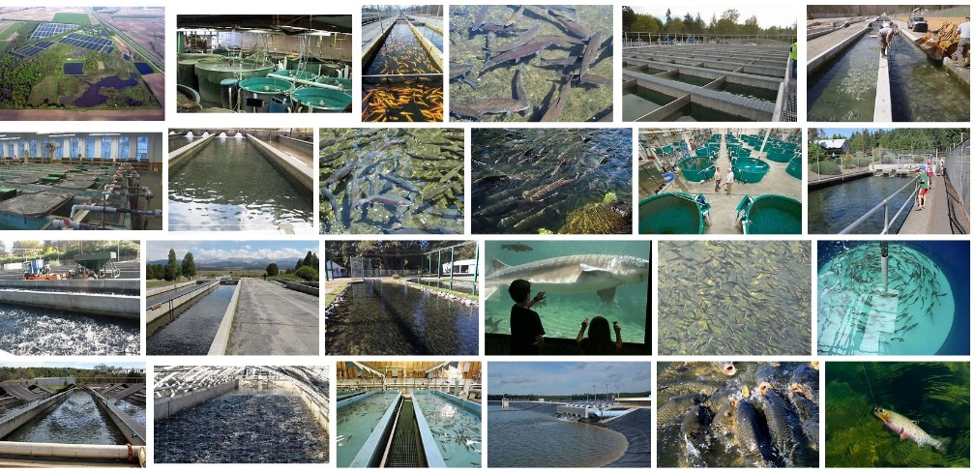
NWFE Programs
Conservation Transportable Hatcheries or remote incubator sites, a new concept- trailerized/ transportable, temporary or long term and easily set up that meet county code with trailers that contain the various components of a hatchery conservation or remote Incubator site program. Whether supporting Natural Origin propagation or hatchery satellite expansion.
Wild Fish Training in hatcheries to improve SARs- we see a lot of hatcheries, hear a lot about hatchery reform but see the same old techniques with the same tired and lacking results. Training hatchery fish to survive once released into rivers effect the adult returns. NWFE bridges aquaculture, tribal and stock enhancement proven and new ideas and concepts to increase smolt survival and SARs, impacting and reducing hatchery cost along the way.
Modern Spawning techniques
Run Timing management
Community Egg Plantings
Satellite programs
Brood stock management
Community Fishing Organizations support
Funding Development

Slide 25
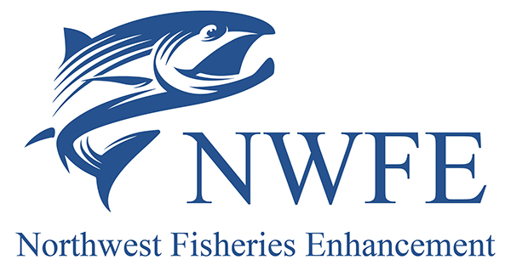
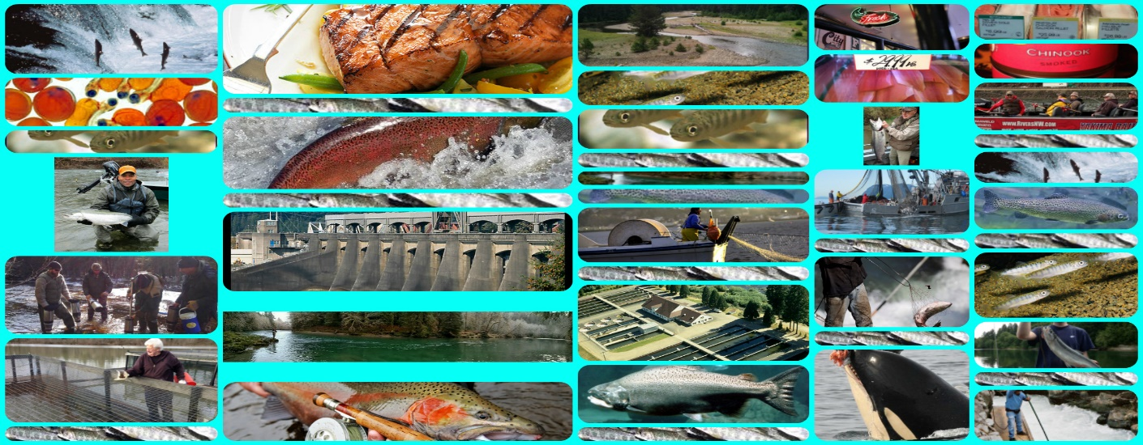
NWFE- A Unique New Fisheries Enhancement Group
6 So 2nd Street Suite 809
Yakima WA 98901
509-292-6410
Nwfe.org
info@nwfe.org

